Slide 1

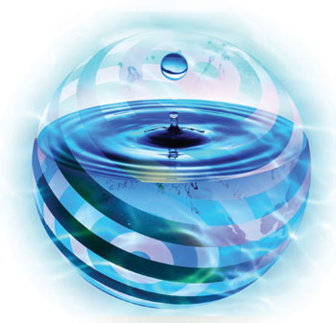




River Modeling
Segmentation and Model Resolution
Finite Segment Method

Slide 2


3.1 Segmentation and Model Resolution
Segmentation = process of dividing space and matter into increments;
Space: a water body can be ÷ into volumes;
For which mass balance equations are written.
3
6
1
2
5
… n
4
7

Slide 3
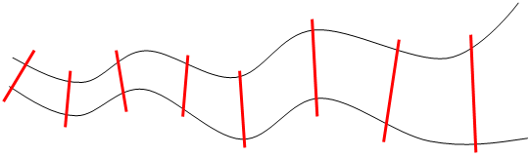
3.1 Segmentation and Model Resolution
Volume: matter may be ÷ into different chemical and biological forms;
For which separate eqns would be written;
n segments + m substances = m × n mass balance eqns.

Slide 4
3.1 Segmentation and Model Resolution
Aside from space and matter, there is a temporal aspect to segmentation;
Related to the fact that mass balance defines changes in water body over a finite period of time;
Model describes additional spatial and material detail by using more segments;
↑ temporal focus: shorter “finite period” or time step for mass balance computation;
Model resolution: degree to which space, time and matter are segmented.

Slide 5
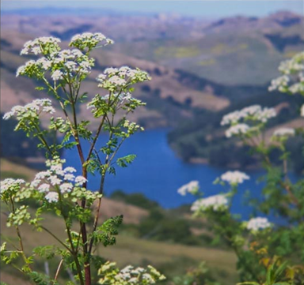
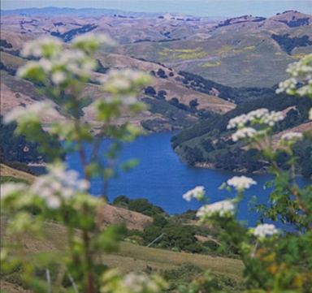
Model Resolution
≈ photography (Camera’s lens focus);
At times the foreground is important;
At other times distant details might be of interest.

Slide 6
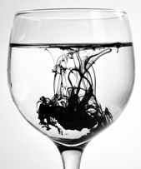
Significance of Model Resolution for WQ analysis
Two basic ways:
Fine-scale phenomenon may have a direct, causative influence on predictions made on the coarser scale;
Influence of the problem context on the choice of scales.

Slide 7
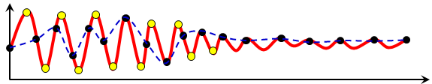
1. Fine scale ⇒ Coarse scale phenomenon
Primarily a function of substance’s properties and physical characteristics of the system;
E.g. certain pollutants (e.g. enteric bacteria) die rapidly upon entering a water body;
∴ typically at ↑ levels near sewage discharge;
↓ rapidly ⇒ background levels in open waters;
Near-shore model of bacterial pollution;
Require relatively fine spatial and temporal segmentation around sewage outfalls.

Slide 8
1. Fine scale ⇒ Coarse scale phenomenon
C ↓ slowly
C ↓ rapidly
Require finer spatial segmentation, particularly near release point

Slide 9
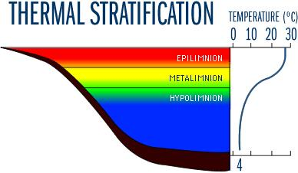
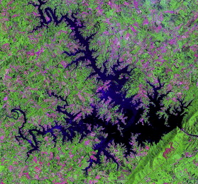
1. Fine scale ⇒ Coarse scale phenomenon
Conservative or slowly reacting substances;
Often can be modelled with coarser schemes;
That treat the whole water body as a single well-mixed segment;
Physical chars dictate segmentation level;
E.g. dendritic lakes - 1 segment unrealistic;
Eutrophication - thermal stratification;
Need multiple vertical.

Slide 10
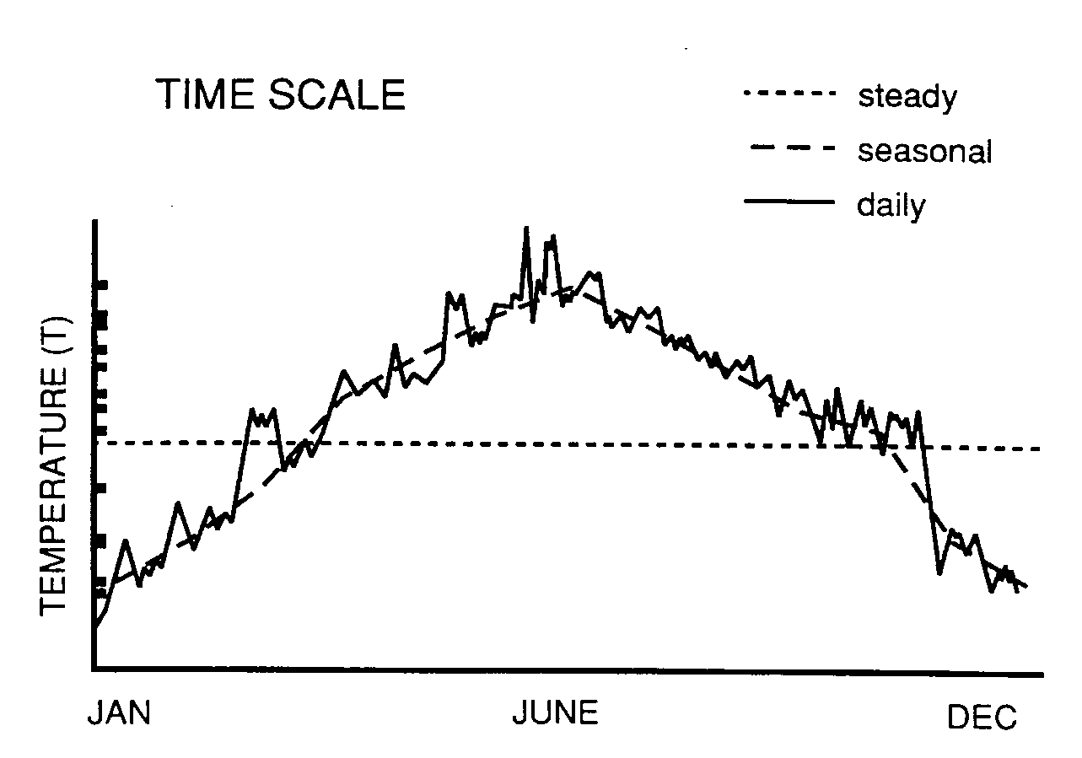
2. Influence of prob context on choice of scales
E.g. phytoplankton go through growth cycles on seasonal time scales and exhibit patchiness on small space scales.
Steady
Seasonal
Monthly
Daily/Hourly

Slide 11


2. Influence of prob context on choice of scales
But WQ planner might not have the funds to develop models to simulate such short-term variability;
Often occur when large numbers of small lakes were being evaluated.

Slide 12
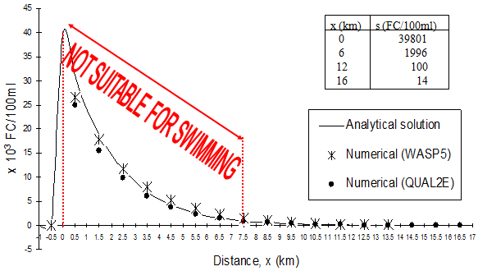
2. Influence of prob context on choice of scales
Spatial and temporal aggregation results in negligible loss of relevant planning info;
Opt for a coarser scale model;
Bacterial contamination of beaches;
Finer scale approach is necessary;
To handle the problem effectively.

Slide 13
3.1 Segmentation and Model Resolution
Temporal, spatial and kinetic scales of a problem often are interrelated;
Fast kinetic processes, e.g. jet mixing of thermal effluents or bacterial die-off ;
Tend to manifest themselves on local (i.e. small) time and space scales;
Problems with slow reactions, e.g. decay of persistent contaminants;
Important on whole-system, long-term basis.

Slide 14
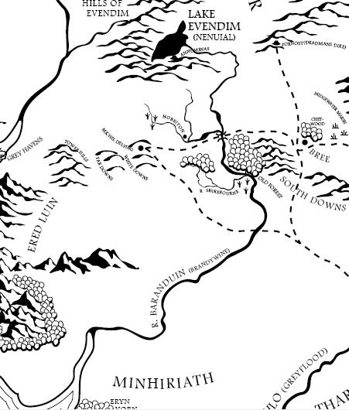
3.2 Finite Segment Method
Water body is often ÷ into a series of computational elements called segments;
To account for variations over the water body;
Levels of substances at various locations;
1
2
3
4
10
5
6
7
9
8

Slide 15
3.2 Finite Segment Method
Best not to have too many segments than necessary;
Imply a greater level of detail than is generally possible to parameterize;
Greater opportunity for error (modify param);
Comp. less efficient;
Calibration difficult.

Slide 16
Segmentation Considerations
Spatial scale of the problem
Segment of a water body (e.g., reach, embayment)
Whole water body (e.g., main river, lake, estuary)
Whole river basin network

Slide 17
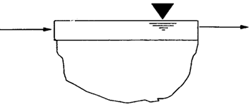
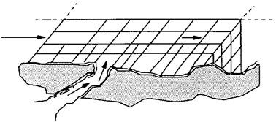
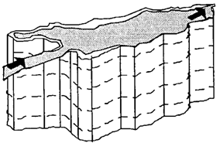
Segmentation Considerations
Dimensionality and spatial discretization of segments
Box, 1-, 2-, 3-dimensions
Horizontal: tens of meters to tens of kilometers
Vertical: whole water column to tens of cm;

Slide 18
Segmentation Considerations
Physical components
Water column (epilimnion, hypolimnion)
Benthic sediments (surface, subsurface)
Model limitations
Maximum # of Segments 3000
Maximum # of Time Pairs 4000

Slide 19
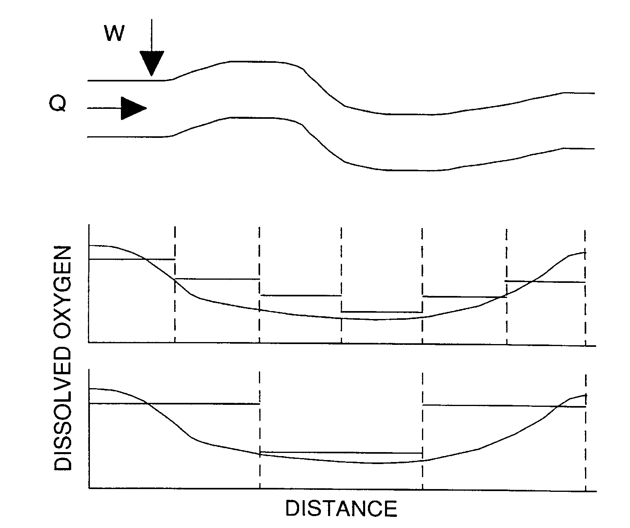
Segmentation Considerations
Network scale determines how precisely the model will be able to reproduce observed gradients.

Slide 20
3.2 Finite Segment Method
FSM - segmentation of model ecosystems;
Into various “completely mixed” boxes;
Of known volume and interchange;
Process known as compartmentalization;
Popular assumption in fate modelling;
Because assumption of complete mixing;
Reduces the set of PDEs (in time and space);
To one of ODEs (in time only).

Slide 21
3.2 Finite Segment Method
Nevertheless, it is possible to recover some coarse spatial information;
By introducing a number of interconnected segments/compartments;
Interchange between segments is simulated via bulk dispersion or equal counterflows between segments.
11
9
1
2
3
4
5
6
7
10
8

Slide 22
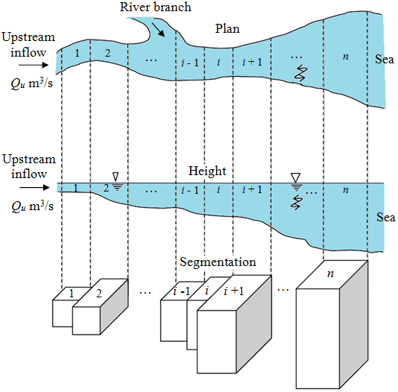
3.2 Finite Segment Method
Estuary width gradually ↑ towards sea;
Laterally and vertically well-mixed;
Concentration gradient along the x-axis.
Figure 3.1 Simple representation of an estuary with finite segments

Slide 23
3.2 Finite Segment Method
A substance reaction in a water body is important aspect of the substance’s fate in the environment;
But an equally important process has to do with the rate of a substance’s transport in the aquatic environment;
A substance is transported by water movement and may undergo additional transport processes such as decay or sedimentation.

Slide 24
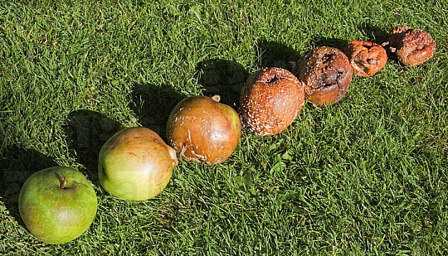
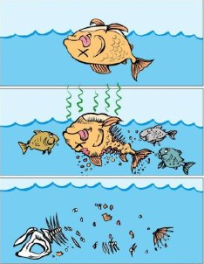
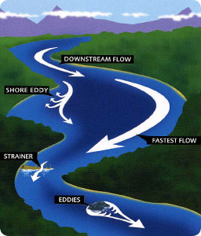
Transport Processes
Decay – substance reduced in mass due to decomposition or sedimentation;
Advection – sub movement at current velocity;

Slide 25
Diffusion and Dispersion
Diffusion: process where a constituent moves from a higher concentration to a lower concentration.
Dispersion:
process by which substance is mixed within water column.
mixing caused by physical processes.
time

Slide 26
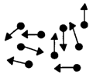
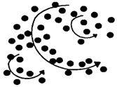
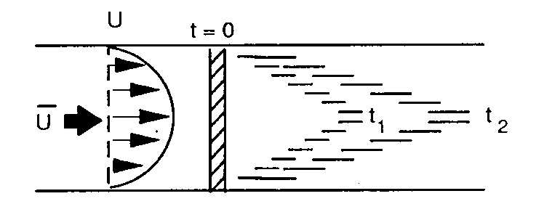
Dispersion
3 processes contribute to mixing (dispersion):
Molecular diffusion,
Turbulent diffusion, and
Dispersion.
Random motion of particles
Turbulent mixing of particles
Mixing caused by variations in velocities

Slide 27
1. Molecular diffusion
Mixing of dissolved substances;
Due to random walk of molecules within fluid;
Caused by kinetic energies of molecular vibrational, rotational and translational motion;
In essence, molecular diffusion corresponds to an increase in entropy;
Move from regions of high concentration to regions of low concentration;
According to Fick’s laws of diffusion.

Slide 28
1. Molecular diffusion
Generally not an important process;
In the transport of dissolved substances in natural waters;
Except relating to transport through thin and stagnant films ;
At the air-water interface or transport through sediment pore water.

Slide 29
2. Turbulent diffusion
@ Eddy diffusion;
Mixing of dissolved substances caused by microscale turbulence;
Advective process at microscale level caused by eddy fluctuations in turbulent shear flow;
Shear forces within the body of water are sufficient to cause this form of mixing;
Several orders of magnitude > mol. diffusion;
A contributing factor in dispersion.

Slide 30
3. Dispersion
Interaction of turbulent diffusion with velocity gradients;
Caused by shear forces in the water body;
Greater degree of mixing known as dispersion;
Transport of substances in streams and rivers;
Is predominantly by advection;
But transport in lakes and estuaries is often dispersion-controlled.

Slide 31
Mathematical Representations
Diffusion:
Fick’s First Law of Diffusion
Dispersion:
Analogous to Fick’s First Law

Slide 32
Range of Values for Dispersion
Process | Direction | Typical Range [m²/s]
Molecular Diffusion | Vertical | 10⁻⁸ to 10⁻⁹
 | Lateral | 10⁻⁸ to 10⁻⁹
 | Longitudinal | 10⁻⁸ to 10⁻⁹
Turbulent Diffusion | Vertical | 10⁻⁶ to 10⁻²
 | Lateral | 10⁻² to 10²
 | Longitudinal | 10⁻² to 10²
Dispersion | Vertical | 10⁻³ to 10⁻¹
 | Lateral | 10⁻² to 10⁰
 | Longitudinal | 10⁻¹ to 10⁴

Slide 33
Dispersion Coefficients
Condition | Dispersion Coefficient [m²/s]
Molecular Diffusion | 10⁻⁹
Compacted Sediment | 10⁻¹¹ to 10⁻⁹
Bioturbated Sediment | 10⁻⁹ to 10⁻⁸
Lakes – Vertically | 10⁻⁶ to 10⁻⁴
Large Rivers – Lateral | 10⁻⁴ to 10⁻³
Large Rivers – Longitudinal | 10⁰ to 10²
Estuaries – Longitudinal | 10² to 10³

Slide 34
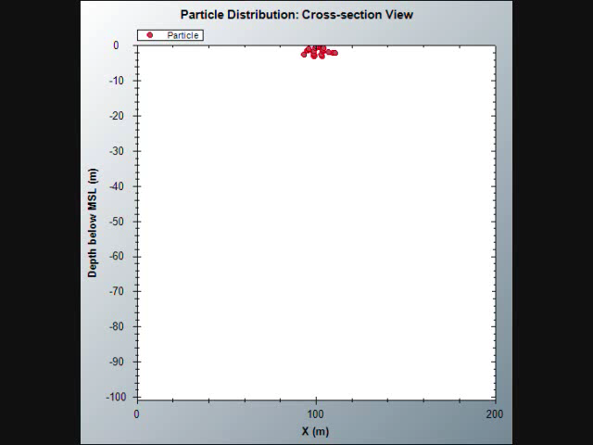
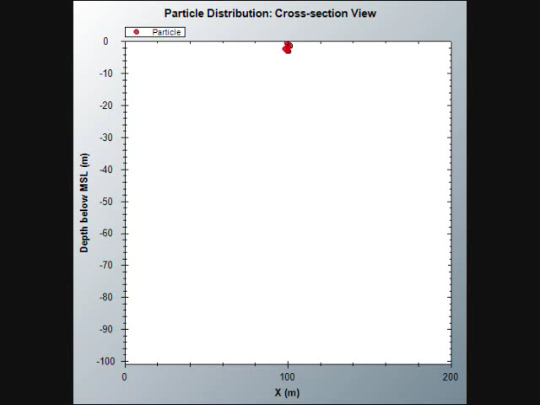
Dispersion

Slide 35

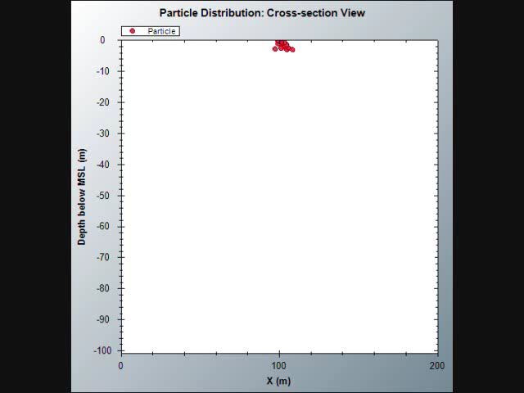
Dispersion + Advection

Slide 36
3.2 Finite Segment Method
∴ mass balance equation at i^{th} segment is influenced by four components;
source of substance s.
transport of the substance s by current of the water (advective flow);
transport of the substance s due to mixing within the water body (dispersion);
loss of mass due to decay process;

Slide 37
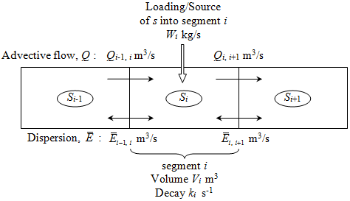
3.2 Finite Segment Method
∴ mass balance equation at i^{th} segment is influenced by four components;
transport of the substance s by current of the water (advective flow);
transport of due to mixing within the water body (dispersion);
loss of mass due to decay process;
source of substance s.

Slide 38
3.2 Finite Segment Method

Slide 39
(i) Advective Flow
Mass per unit time for s that enters and exits segment i due to advective flow Q m³/s;
Input of mass kg/s from upstream segment:
(3.1)

Slide 40
(i) Advective Flow
Transport of mass by advective flow that exits segment i:
(3.2)

Slide 41
(ii) Dispersion
Mass change due to diffusion and mixing;
Transport directly proportional to mass conc difference between two adjacent segments;
Exchange of mass between segment i and segment i – 1 due to dispersion:
(3.3)

Slide 42
(ii) Dispersion
Exchange of mass between segment i and segment i + 1 due to dispersion:
(3.4)

Slide 43
(ii) Dispersion
S_{i-1} > S_{i} : mass from Seg i-1 to i;
S_{i} > S_{i-1} : mass from Seg i to i-1;
Similarly for interface of Seg i and i+1;
Bulk dispersion coefficient is related to E:
(3.5)

Slide 44
(ii) Dispersion
(3.5)
A_{i-1, i} m² = CS area between Seg i and i-1;
m = mean length between Seg i and i-1;
Figure 3.3 Cross sectional area, mean length and segment length

Slide 45
(iii) Decay
For mass loss due to first-order decay process:
with k_{i} s⁻¹ = decay coefficient of segment i.
V_{i} m³ = volume of segment i.
(3.6)

Slide 46
(iv) Sources and Sinks
Source or sink of substance s:
+
(3.7)

Slide 47
3.2 Finite Segment Method
Total quantity of all masses obtained must;
= Rate of change in mass at segment i;
for with V_{i} constant;
Good approximation for most estuaries.
(3.8)

Slide 48
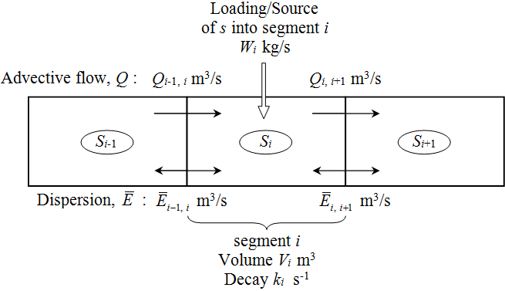
Overall Mass Balance at Segment i
(3.9)
Figure 3.2 Notations for segment i illustrating advective flow, dispersion, mixing and decay of substance s.
S_{i-1}
S_{i}
S_{i+1}

Slide 49
3.2 Finite Segment Method
(3.9)
Eqn (3.9) is a numerical approx of
(3.10)

Slide 50
3.2 Finite Segment Method
1st - order linear ODE, time-dependent;
Assume steady-state, i.e. input, flow, exchange and reaction rate do not change with time:
n segments ⇒ n number of Eqn (3.9).
⇒ Eqn (3.9)
= linear algebraic eqn

Slide 51
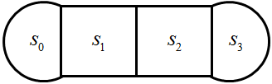
3.2 Finite Segment Method

Slide 52
3.2 Finite Segment Method
Segment 1:
(3.11)
S_{u}
S₁
S₂
…

Slide 53
3.2 Finite Segment Method
Segment n:
(3.12)
…
S_{n-1}
S_{n}
S_{b}

Slide 54
3.2 Finite Segment Method
Group to the left all terms with s_{i-1}, s_{i}, s_{i+1};
(3.13)

Slide 55
3.2 Finite Segment Method
Let:
(3.14)
(3.15)
(3.16)
Eqn (3.13) can be simplified to
(3.17)

Slide 56
3.2 Finite Segment Method
Segment 1:
(3.18)
(3.19)
(3.11)
S_{u}
S₁
S₂
…

Slide 57
3.2 Finite Segment Method
Segment n:
(3.20)
(3.12)
(3.21)
…
S_{n-1}
S_{n}
S_{b}

Slide 58
3.2 Finite Segment Method
∴ The complete set of eqns for n segments:
(3.22)

Slide 59
3.2 Finite Segment Method
In matrix form:
(3.23)

Slide 60
3.2 Finite Segment Method
(3.23) : Boundary value problem-steady-state;
Boundary conditions: s_{u} and s_{b};
FSM – can only be solved easily by hand;
For systems of dimension 3 by 3;
River pollution - complex matter;
Requires division of river into many segments;
For more accurate and reliable solution.
⇒ system of equations with high dimensions;
Numerical method - I1DISP (Koh, 2004).

Slide 61
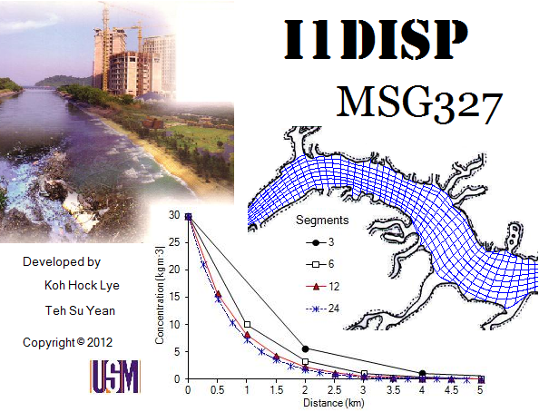
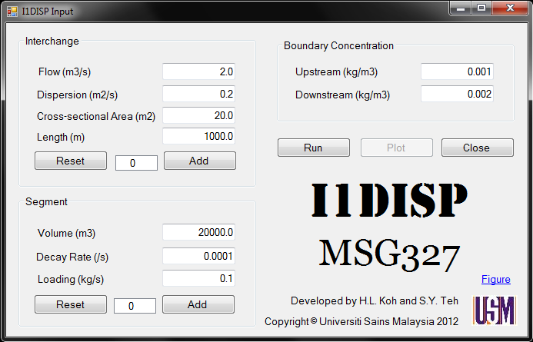
I1DISP – Steady-state Model

Slide 62
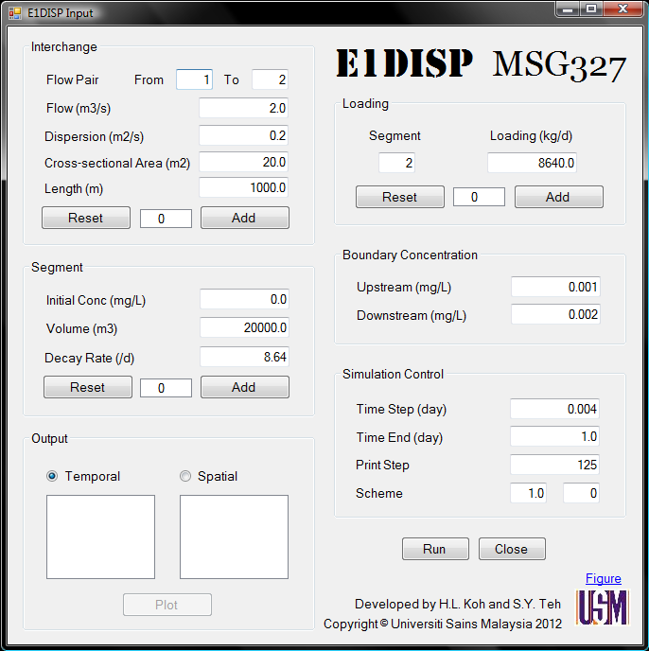
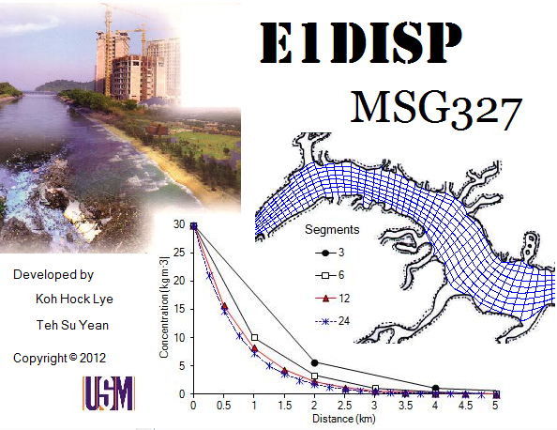
3.2 Finite Segment Method
Non steady-state, ds/dt ≠ 0;
Initial condition;
Initial value problem;
Runge Kutta methods;
E1DISP.

Slide 63
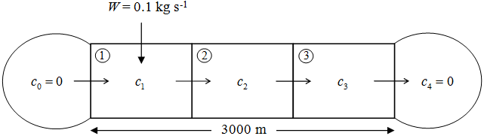
Example 3.1
Consider a uniform river with cross sectional area A = 20 m², length L = 3000 m, velocity u = 0.1 m/s and dispersion coefficient E = 0.0 m²/s. This river is divided into three uniform segments with Δx = 1000 m for each segment.

Slide 64
Example 3.1
A chemical is released into segment 1 of the river at the rate of W = 0.1 kg s⁻¹. This chemical decays at the rate of k = 10⁻⁴ s⁻¹. The water at the upstream and downstream segments is assumed to have a chemical concentration of 0.0 kg m⁻³.
Find the concentration for every segment c₁, c₂, c₃ after the steady state is achieved.

Slide 65
Example 3.1
A = 20 m² L = 3000 m u = 0.1 m/s
E = 0.0 m²/s Δx = 1000 m W = 0.1 kg/s
k = 10⁻⁴ s⁻¹

Slide 66
Example 3.1

Slide 67
Example 3.1

Slide 68
Example 3.2
Consider a uniform river with cross sectional area A = 20 m², length L = 3000 m, velocity u = 0.1 m/s and dispersion coefficient E = 0.2 m²/s. This river is divided into three uniform segments with Δx = 1000 m for each segment.

Slide 69
Example 3.2
A chemical is released into segment 1 of the river at the rate of W = 0.1 kg s⁻¹. This chemical decays at the rate of k = 10⁻⁴ s⁻¹. The water at the upstream and downstream segments is assumed to have a chemical concentration of 0.0 kg m⁻³.
Find the concentration for every segment c₁, c₂, c₃ after the steady state is achieved.

Slide 70
Example 3.2
A = 20 m² L = 3000 m u = 0.1 m/s
E = 0.2 m²/s Δx = 1000 m W = 0.1 kg/s
k = 10⁻⁴ s⁻¹

Slide 71
Example 3.2 - Solution

Slide 72
Examples 3.1 & 3.2: Comparison
c (mg/L) | x (m)
 | 0 | 1000 | 2000 | 3000 | 4000
Example 3.1 | 0 | 25 | 12.5 | 6.25 | 0
Example 3.2 | 0 | 24.96 | 12.49 | 6.24 | 0

Slide 73
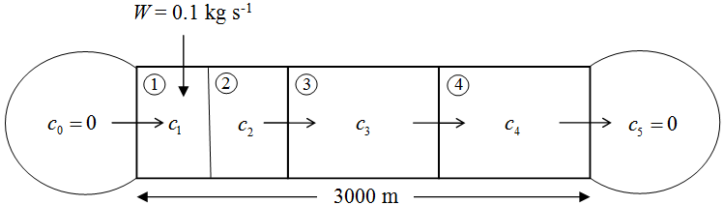
Example 3.3
A = 20 m² L = 3000 m u = 0.1 m/s
E = 0.0 m²/s Δx = 1000 m W = 0.1 kg/s
k = 10⁻⁴ s⁻¹

Slide 74
Example 3.3 - Solution

Slide 75
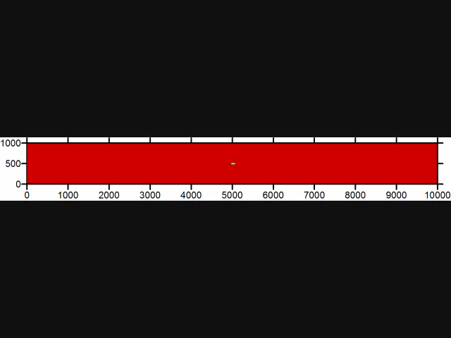
2D Water Quality

Slide 76

Thank You

